Slide 1
DATA INGESTION USING: FLUME, KINESIS, KAFKA & SAMZA
By:
Anirudha Bedre
Avikal Chhetri

Slide 2

What is Data Ingestion ?
Data ingestion is the process of obtaining, importing and processing data for later use or storage in a database.

Slide 3
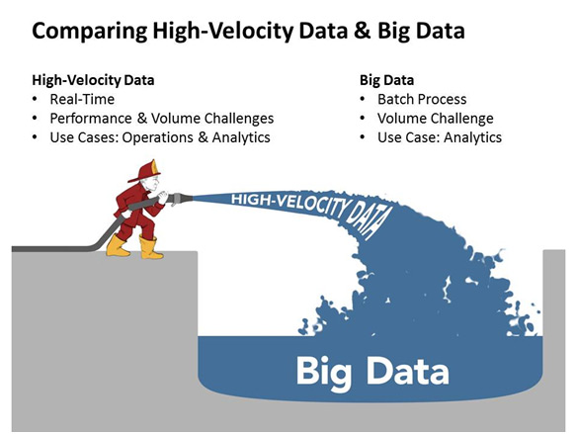
High Velocity Data

Slide 4

Data Streaming
A stream is a sequence of data elements made available over time.
A stream can be thought of as items on a conveyor belt being processed one at a time rather than in large batches.

Slide 5
Stream Processing
Stream processing enables organizations to:
Analyze and act up upon rapidly changing data in real time
Enhance existing models with new insights
Capture, analyze and act on insight before opportunities are lost, forever
Move from batching process to real-time analytics and decisions

Slide 6
Top use cases for stream processing
Internet of Things (IoT) – Optimize availability, performance, capacity and resource utilization
Real-time sentiment analysis of social media – Effectively respond to improve the client experience
Enhanced security intelligence – Predict, prevent and act on security threats and real-time fraud detection. Increase situational awareness.
Next best action – Act on up-to-the-second observations, while the event/transaction is still happening

Slide 7

Messaging Systems
Messaging systems are a popular way of implementing near-realtime asynchronous computation.
Messages can be added to a message queue (ActiveMQ, RabbitMQ), pub-sub system (Kestrel, Kafka), or log aggregation system (Flume, Kinesis) when something happens.
Notes:
Suppose you have a website, and every time someone loads a page, you send a “user viewed page” event to a messaging system. You might then have consumers which do any of the following:
Store the message in Hadoop for future analysis
Count page views and update a dashboard
Trigger an alert if a page view fails
Send an email notification to another user
Join the page view event with the user’s profile, and send the message back to the messaging system
A messaging system lets you decouple all of this work from the actual web page serving.

Slide 8
Messaging Systems – An example
Suppose you have a website, and every time someone loads a page, you send a “user viewed page” event to a messaging system. You might then have consumers which do any of the following:
Store the message in Hadoop for future analysis
Count page views and update a dashboard
Trigger an alert if a page view fails
Send an email notification to another user
Join the page view event with the user’s profile, and send the message back to the messaging system

Slide 9


APACHE FLUME
Apache Flume is a distributed, reliable and available system for efficiently collecting, aggregating and moving large amounts of log data from many different sources to a centralized data store.
Latest version 1.6.0 released on May 20, 2015

Slide 10
APACHE FLUME
Flume supports the following mechanisms to read data from popular log stream types, such as:
Avro
Thrift
Syslog
Netcat

Slide 11
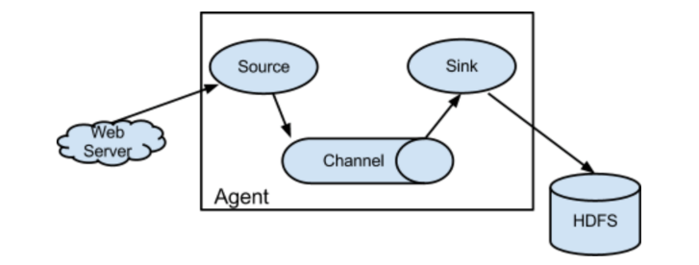
APACHE FLUME
ARCHITECTURE
Data Flow Model (Single Hop)
External source provides an event:
eg: Web Server

Slide 12
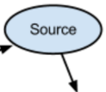
APACHE FLUME
Component Description
Flume Source:
Avro Source- Listens on Avro port and receives events from external Avro client streams or create a tiered collection from previous hop.
Syslog Source- Reads syslog data and generate Flume events.
Legacy Sources- The legacy sources allow a Flume 1.x agent to receive events from Flume 0.9.4 agents

Slide 13

APACHE FLUME
Component Description
Flume Channel:
Memory Channel: The events are stored in a an in-memory queue with configurable max size. Ideal for higher throughput, event of data loss by agent failure.
JDBC Channel: The events are stored in a persistent storage that's backed by a database. Ideal when recoverability is important.
Pseudo Transaction Channel: Only for unit testing purposes (in production stages)

Slide 14

APACHE FLUME
Component Description
Flume Sinks:
HDFS Sink- This sink writes events into the HDFS. It currently supports creating text and sequence files.
Avro Sink- Events sent to this sink are turned into Avro events and sent to the configured hostname / port pair. This sink forms one half of Flume's tiered collection support.
HBase Sink- This sink writes data to HBase. The Hbase configuration is picked up from the first hbase-site.xml encountered in the classpath.

Slide 15
APACHE FLUME
Flume Source stores event in 1 or more channels
Sink consumes the event from passive storage channel
Sink puts the event into an external repository like HDFS
External source provides an event. Eg: Web Server
Or Flume source of the next Flume agent (next hop)
Flume event is defined as a unit of data flow that contains a payload (byte-array)
A Flume agent is a process (JVM) that hosts all components and allows Events to flow from an external source to a external destination.

Slide 16
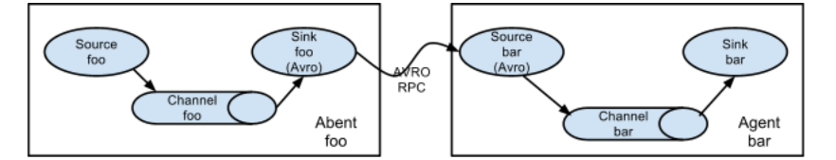
APACHE FLUME
ARCHITECTURE
Data Flow Model (Multi Agent Hop)
In order to flow the data across multiple agents or hops, the sink of the previous agent and source of the current hop need to be of same type.

Slide 17
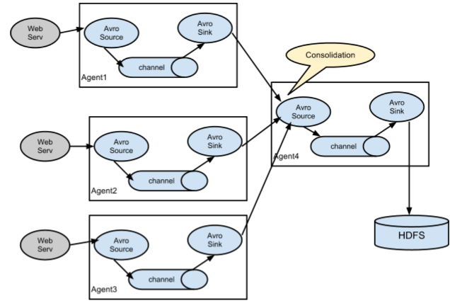
APACHE FLUME
ARCHITECTURE
Data Flow Model (Consolidation)
Large number of log producing clients sending data to a few consumer agents

Slide 18
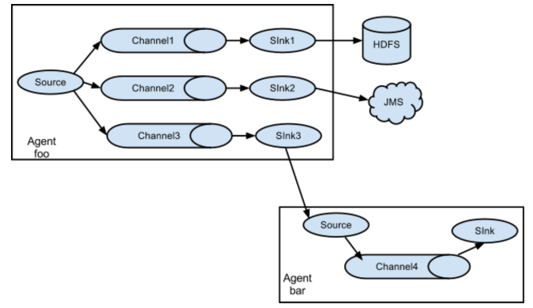
APACHE FLUME
ARCHITECTURE
Data Flow Model (Multiplexing Flow)
Replicate or selectively routing an event to one or more channels.
In Multiplexing , an event is delivered to a subset of available channels

Slide 19
APACHE FLUME
FLUME SECURITY
The HDFS sink supports Kerberos authentication if the underlying HDFS is running in secure mode

Slide 20
AMAZON KINESIS
For processing continuous stream of data in the form of:
Logs from servers
Social media feeds
web clickstream data
market data feeds
Amazon Kinesis takes in large streams of data for processing in real time

Slide 21
AMAZON KINESIS
Key Concepts:
Shards: Capacity of a data stream is expressed in terms of shards. 1000 write Tx (up to 1 MB/second), 5 read Tx (up to 2 MB/second)
Producers: They put records into Kinesis streams. Eg, a web server sending log data
Consumers: They get records from Kinesis streams and process them
Partition Keys: A partition key is used to group data by shard within a stream

Slide 22
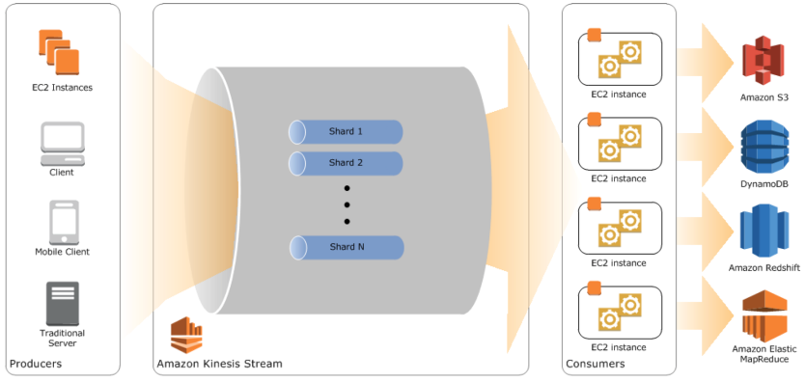
AMAZON KINESIS
High-level architecture of Amazon Kinesis

Slide 23
AMAZON KINESIS
The Kinesis Processing Model
Producer side of your application code will use the PutRecord function to store data in a stream
Consumer side of your application code reads through data in a shard sequentially in 2 steps.
GetShardIterator to specify the position in the shard to start reading data
GetNextRecords to retrieve up to 2 MB/s of data using the shard iterator.
3. After processing, the data can be :
Passed to another Kinesis stream
Amazon S3 bucket
Redshift DW
Discarded

Slide 24
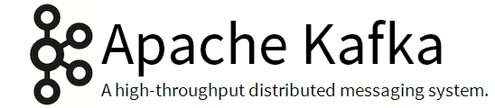
Kafka is a distributed, partitioned, replicated commit log service. It provides the functionality of a messaging system, but with a unique design.
Kafka maintains feeds of messages in categories called topics.
We'll call processes that publish messages to a Kafka topic producers.
We'll call processes that subscribe to topics and process the feed of published messages consumers..
Kafka is run as a cluster comprised of one or more servers each of which is called a broker.

Slide 25
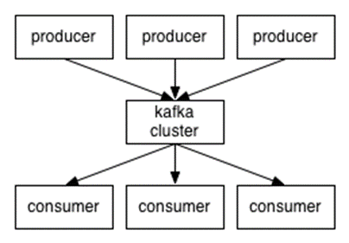
Producers send messages over the network to the Kafka cluster which in turn serves them up to consumers.

Slide 26
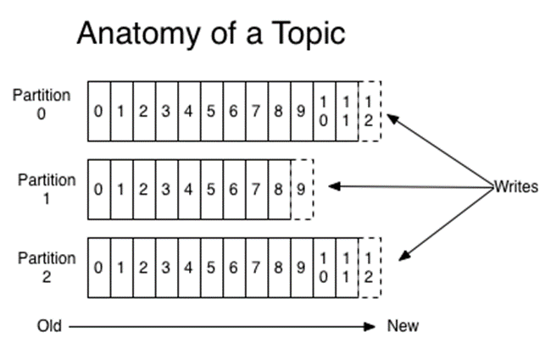
Kafka - Anatomy of a Topic
A topic is a category or feed name to which messages are published. For each topic, the Kafka cluster maintains a partitioned log that looks like this:

Slide 27

.
Samza is a stream processing framework. It was originally developed and open-sourced by LinkedIn.
Simple API
Managed state
Fault tolerance
Durability
Scalability
Pluggable

Slide 28
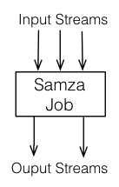
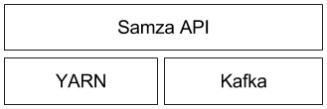
.
Architecture
Samza is made up of three layers:
A streaming layer (Kafka).
An execution layer (YARN).
A processing layer (Samza API).

Slide 29
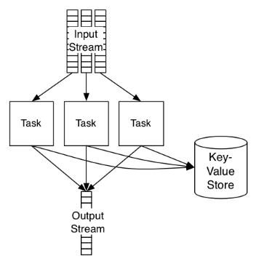
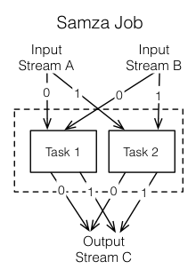
Samza – Job Processing

Slide 30
YARN
YARN (Yet Another Resource Negotiator) is Hadoop’s next-generation cluster scheduler. It allows you to allocate a number of containers (processes) in a cluster of machines, and execute arbitrary commands on them.
Application: I want to run command X on two machines with 512MB memory.
YARN: Cool, where’s your code?
Application: http://path.to.host/jobs/download/my.tgz
YARN: I’m running your job on node-1.grid and node-2.grid.

Slide 31
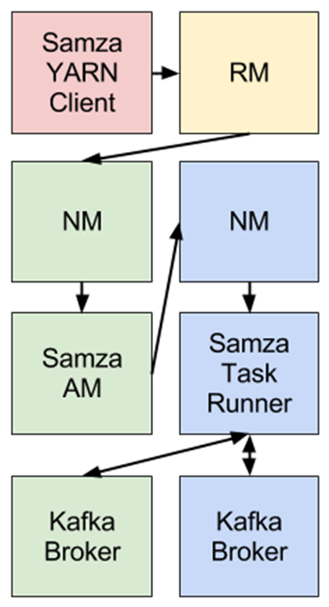
Samza & YARN
YARN has three important pieces: a ResourceManager, a NodeManager, and an ApplicationMaster.
Samza provides a YARN ApplicationMaster and a YARN job runner out of the box.

Slide 32
Samza Vs Spark Streaming
Apache Samza | Spark Streaming
Samza processes messages as they are received. | Spark Streaming treats streaming as a series of deterministic batch operations. Spark Streaming groups the stream into batches of a fixed duration (such as 1 second)
Samza guarantees processing the messages as the order they appear in the partition of the stream | Spark Streaming guarantees ordered processing of RDDs in one DStream. Since each RDD is processed in parallel, there is not order guaranteed within the RDD
Samza jobs can have latency in the low milliseconds when running with Apache Kafka. | Latency as low as one second.

Slide 33
Samza Demo

Slide 34
Comparison
Apache FLUME | AWS KINESIS | Apache Samza
Processing large amounts of log centric data | Processes website clickstreams, social media feeds, IT logs, and location-tracking events | Distributed stream processing framework. Kafka – messaging YARN - fault tolerance, security
Variation in transaction speeds for multi hop when sink (read) takes longer than source (write) | Each shard can support up to 1 MB/second read , up to 2 MB/second write operation | Producer pushes 50MB/sec to the system Consumer can read 100MB/sec

Slide 35
Flume Integration with Spark
Approach 1: Flume-style Push-based Approach
Spark sets up a receiver that acts as Avro agent to Flume, to which Flume can push the data.
Approach 2: Pull-based Approach using a Custom Sink
Flume pushes data into the sink & Spark uses a reliable Flume receiver to pull data from sink. Data is replicated for stronger reliability and fault tolerance.

Slide 36
Kinesis Integration with Spark
Configuring Spark Streaming Application by linking with Kinesis library
In the streaming application code, import KinesisUtils and create the input Dstream
Deploy Package spark-streaming-kinesis-asl_2.10 and its dependencies into the application JAR

Slide 37
References
THANK YOU !
https://aws.amazon.com/blogs/aws/amazon-kinesis-real-time-processing-of-streamed-data/
http://docs.aws.amazon.com/kinesis/latest/dev/key-concepts.html
https://spark.apache.org/docs/latest/streaming-kinesis-integration.html
https://flume.apache.org/FlumeUserGuide.html
https://spark.apache.org/docs/latest/streaming-flume-integration.html
https://flume.apache.org/releases/content/1.2.0/FlumeUserGuide.pdf
https://samza.apache.org/learn/documentation/0.9/introduction/background.html
http://engineering.linkedin.com/kafka/benchmarking-apache-kafka-2-million-writes-second-three-cheap-machines
http://kafka.apache.org/07/performance.html

